Slide 1



Financial Tracker BI Report
View in Power BI
Last data refresh:
7/17/2024 8:13:53 AM UTC
Downloaded at:
7/17/2024 8:17:58 AM UTC

Slide 2
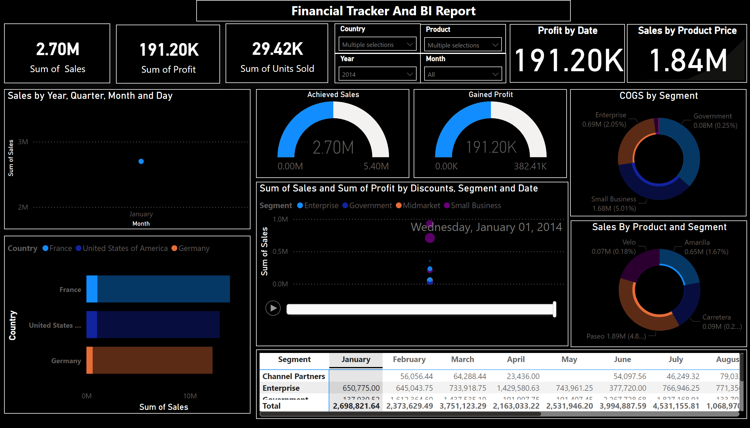
Page 1
Notes:
barChart
No alt text provided
card
No alt text provided
card
No alt text provided
card
No alt text provided
slicer
No alt text provided
slicer
No alt text provided
slicer
No alt text provided
slicer
No alt text provided
Sales by Year, Quarter, Month and Day
No alt text provided
Profit by Date
No alt text provided
Achieved Sales
No alt text provided
scatterChart
No alt text provided
textbox
No alt text provided
Sales by Product Price
No alt text provided
Gained Profit
No alt text provided
Sales By Product and Segment
No alt text provided
pivotTable
No alt text provided
COGS by Segment
No alt text provided

